Slide 1
Heuristics in RL
By Bennett Brain

Slide 2
Concept: apply “advice” to RL agent
RL agents explore blindly at first, with no world information
What if we could give them “tips”, derived from basic understanding of the environment?
  I.E. in four-rooms; “move up and right”
Agent should still explore and determine its own optimal policy eventually
Hypothesis: good “tips” will help agents learn faster but possibly result in same long-term results, especially in more difficult domains

Slide 3
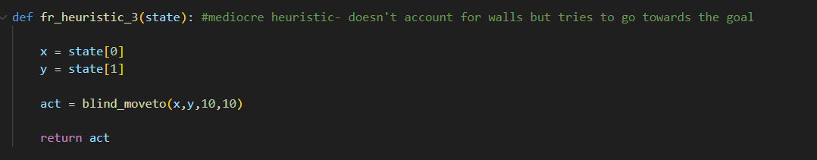
Methods – heuristic policy
Encode “heuristic” policy derived from tips
Example:
This heuristic just has a 50/50 shot of moving “up” or “right” in four rooms (the helper function just moves in X or Y towards the goal until x = goal_x and y = goal_y)
As a policy, it would not solve the environment on its own

Slide 4
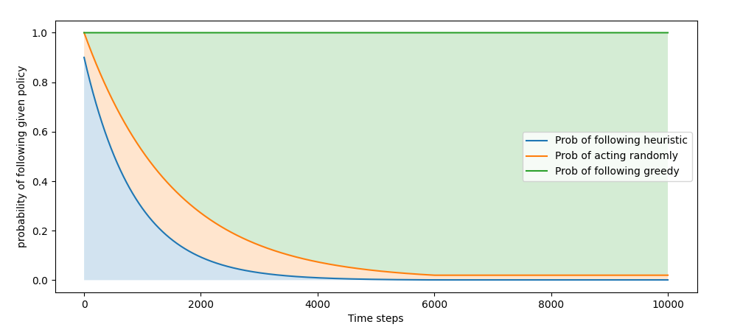
Methods- following the heuristic
How to determine when to use the heuristic vs explore vs use the agent’s own knowledge?
Use heuristic more early
Use learned knowledge
later
Epsilon scheduling!
Generate e1 and e2
  r < e1, follow heuristic
  e1 < r < e2, explore
  e2 < r, follow greedy

Slide 5
Methods- Adversarial Heuristics
What would happen if we applied “bad” advice?
  We should expect training to take longer and the final results to potentially be worse
  This can be implemented as easily as good advice- just make the “heuristic” bad

Slide 6
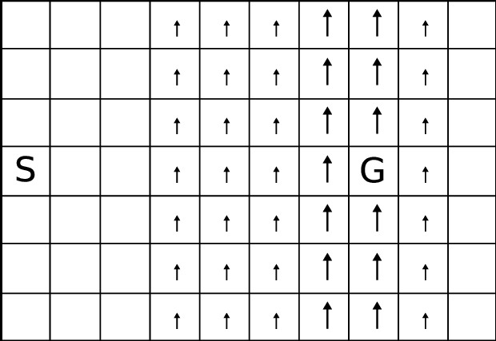
Windy Gridworld: Domain
Path to the goal isn’t obvious, so RL can take a little while, but it’s still an easy domain for fast testing

Slide 7
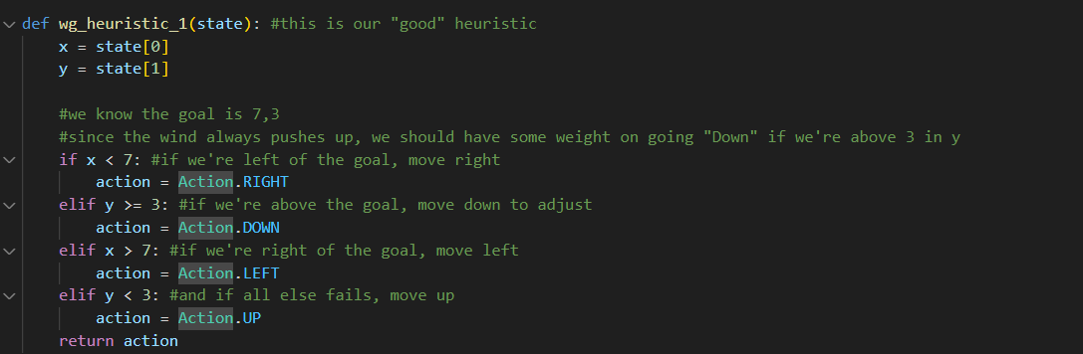
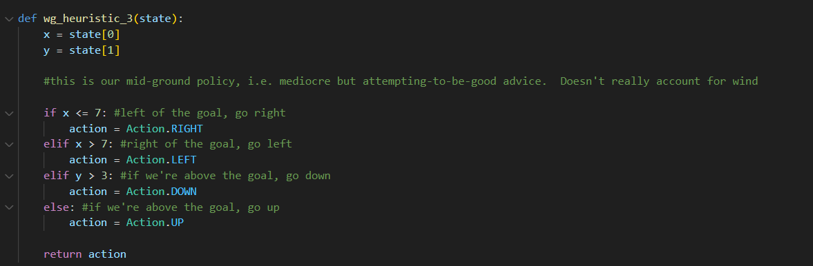
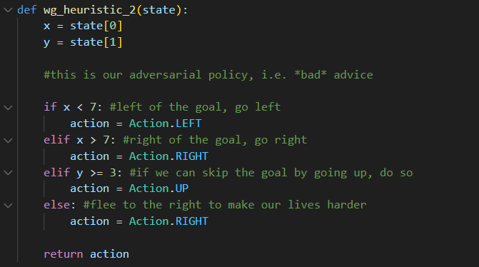
Windy Gridworld: Heuristics
“Good” heuristic:
  Accounts for wind
  Still far from perfect
“Mediocre” heuristic:
  Doesn’t account for wind, just relative position from goal
“Bad” heuristic:
  Move away from goal

Slide 8
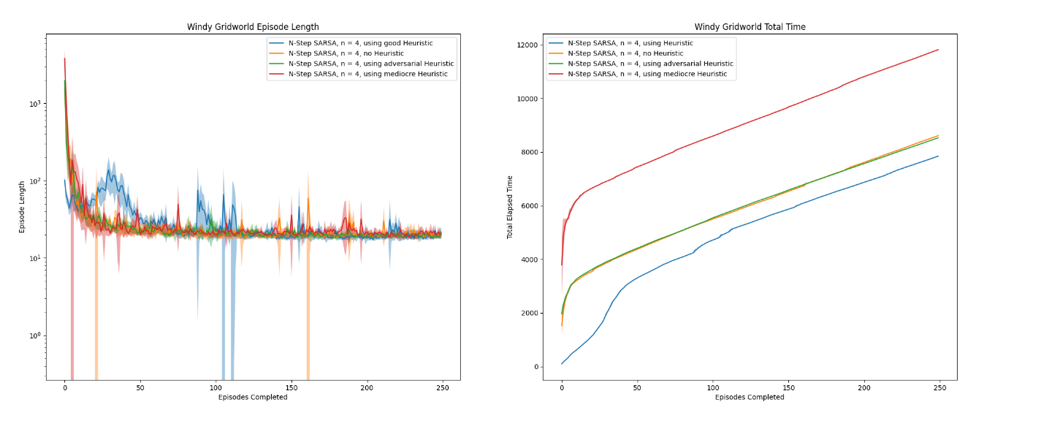
Windy Gridworld: Results
  Good heuristic helps, but not as much info/episode since episodes term early
  Mediocre heuristic is worse than adversarial here
    Environment is hostile to “close but not quite” due to wind near goal

Slide 9
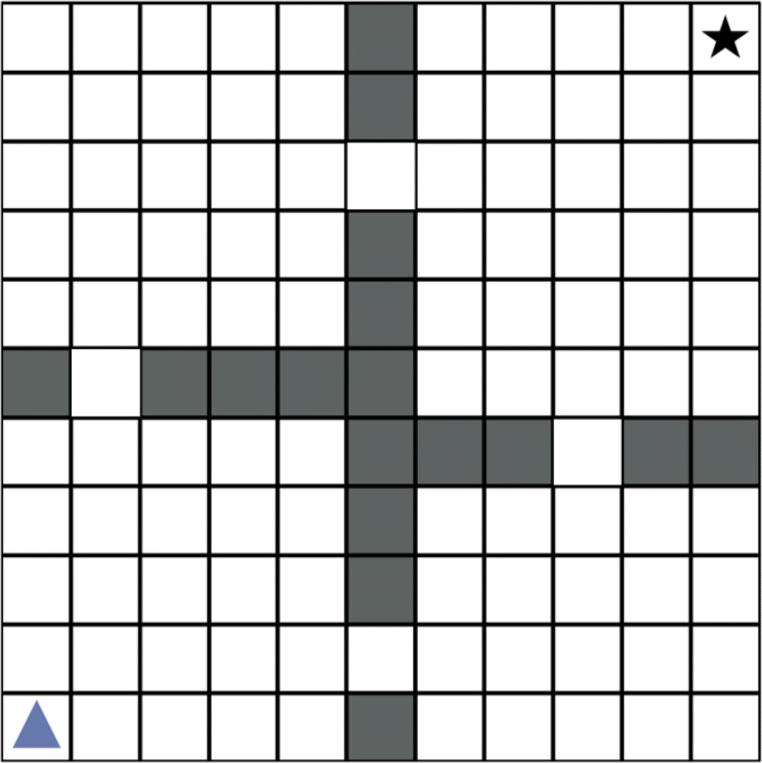
Four Rooms: Domain
Easy for people to see what to do, hard for RL agent
Long walls with small hallways make exploration challenging- lots of ways to get stuck

Slide 10
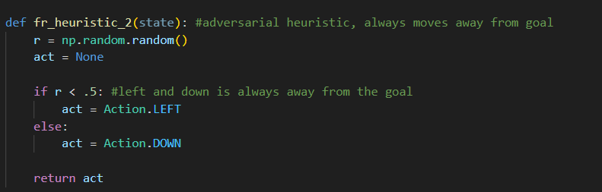
Four Rooms: Heuristics
“Good” heuristic: move towards next hallway to the goal (too many lines to reprint code here)
  I.e. if in up-left room, move to (4,8), if in down-right room, move to (8,4), etc.
“Mediocre” heuristic: move up and right
  Blindly moves towards goal
“Bad” heuristic: move down/left
  Moves away from goal

Slide 11
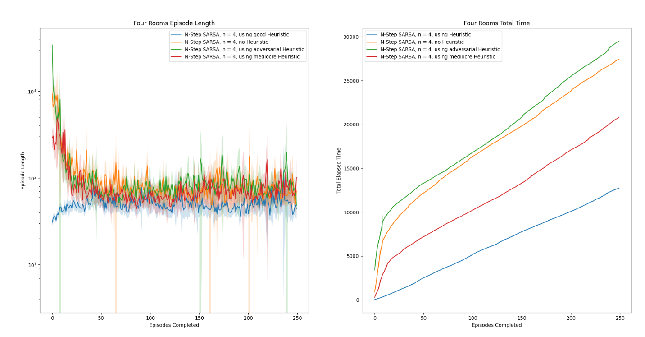
Four Rooms: Results
Good Heuristic helped a lot
Mediocre heuristic still helped here
Bad heuristic actively impeded progress
More sparse reward signal than windy gridworld => heuristics had more impact by “guiding” exploration
Less complex transitions around goal => mediocre heuristic being imprecise was less of an issue

Slide 12
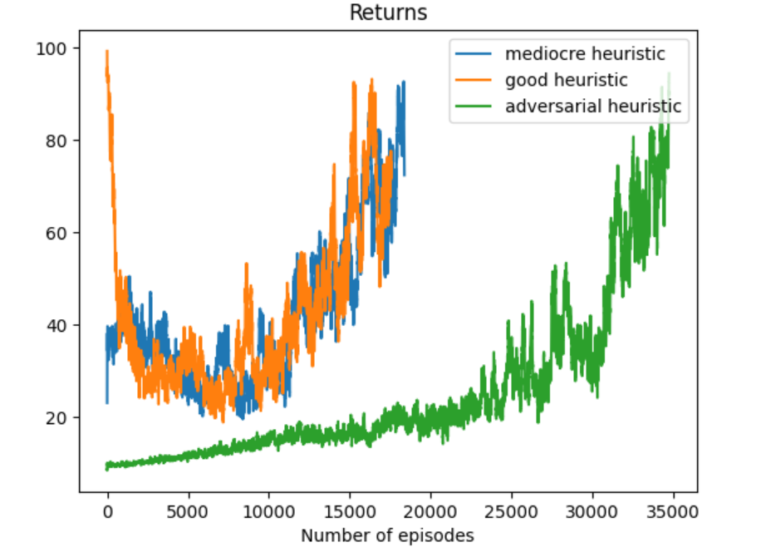
Next steps
Implement on DQN environments
  “What you’ll often see is a notable improvement in the tabular space translate to a small marginal improvement in deep RL” – Prof. Lawson
Currently running back at home!
Early results from Cart-Pole:
  I ran on #steps, not #episodes, so
  the different heuristics ran for different
  #s of episodes

